Slide 1
Bots, gold farmers, glitches and their affects on game economies
Name: Gerard Morris
Date: 31/03/2017
Notes:
Introduce myself ..

Slide 2
Agenda
Bots
Pokemon Go and World of Warcraft
Glitch Abuse
The Witcher 3, Dragon Age, World of Warcraft
Online Economies and the black market
EVE Online and World of Warcraft

Slide 3
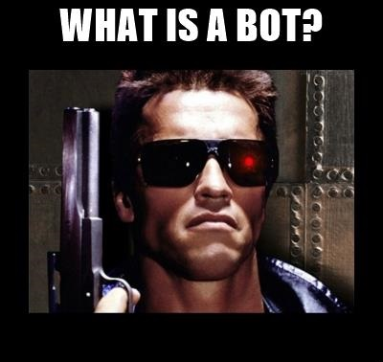
Notes:
So what is a bot? Well in this case we are not talking about a machine out to kill Sarah Conor anyways.

Slide 4
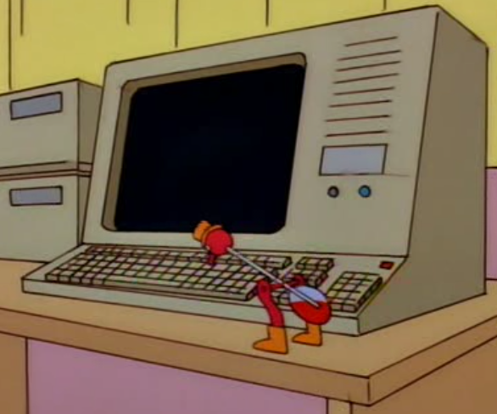
Notes:
In this case, a bot an agent based program that play the games for you while you are unable to or not wanting to. The better ones can manage running multiple accounts at the same time.

Slide 5
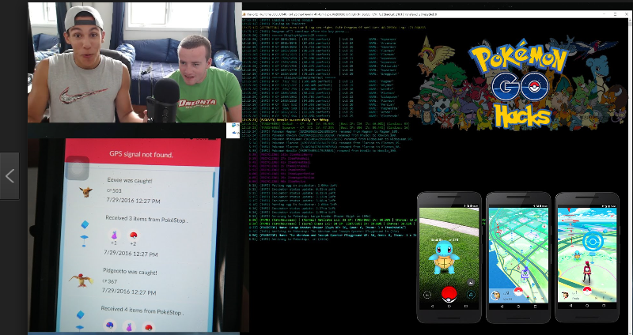
Necrobot – Pokemon Go
Notes:
Pokemon go bots send gps coordinates and you can control the speed at which they move from point to point. They are fully configurable on almost every aspect.

Slide 6
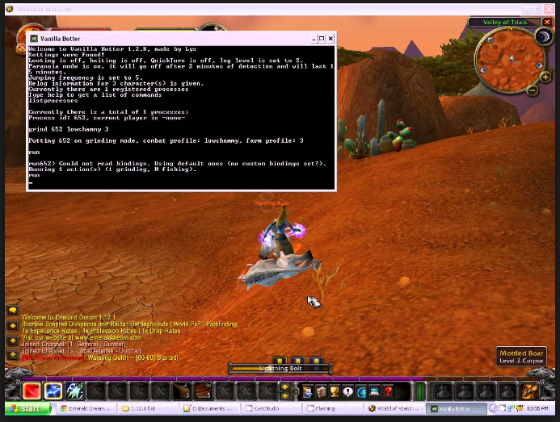
Vanilla Botter– World of Warcraft Vanilla
Notes:
In MMOs they often use what are known as profiles, leveling, grinding, farming. Vanilla Botter is popular on private vanilla servers and Honor Buddy on modern servers. Though Blizzard have got rather good at detecting honor buddy styke bots as I shall show later ;)

Slide 7
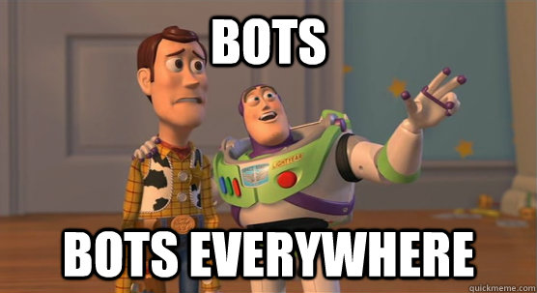
Notes:
Bots are becoming more and more popular, especially in games that require you to grind for things. Most MMOs and newer games like Pokemon Go and these sorts all have issues with it. The issue with a bot is they do not hack or inject anything, so there is no tampering. They are merely playing the game on your behalf generally. There are ways to tell them a part from people such as play time, if they go idle, if they talk, etc. But if a bot is clever and trying to blend in then it gets really hard to spot them for game admins.
Why go to the effort of bots when I can just cheat and type in things like “allyourbasearebelongtous” or use things like I described in a previous presentation like CheatEngine, ArtMoney, Trainers and other stuff.

Slide 8
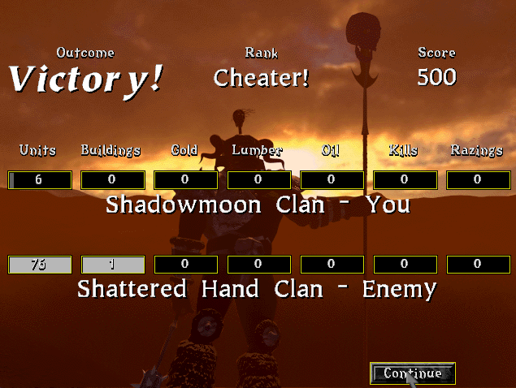
Bots
Notes:
Well games can tell you are cheating and in mmos, most of the stuff is on a server and you are merely on a client. You cannot cheat. So if you want to make your life simpler you have to resort to other means, such as bots! :D

Slide 9
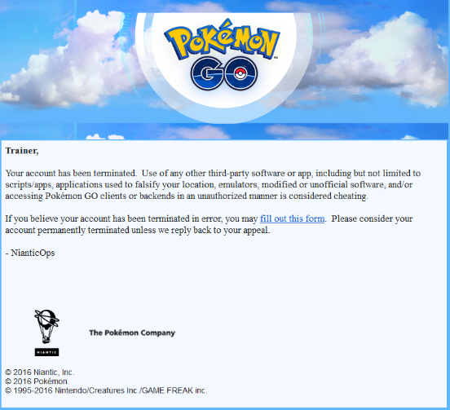
Bots – My Experience
Notes:
So my personal experience with bots. Well like many people I played a lot of Pokemon Go for a while, then got bored. After about 2 weeks of not playing I got this mail.
So I was banned for cheating/inappropriate play?
Eh .. I had not cheated. What gives?
Experiment time!

Slide 10
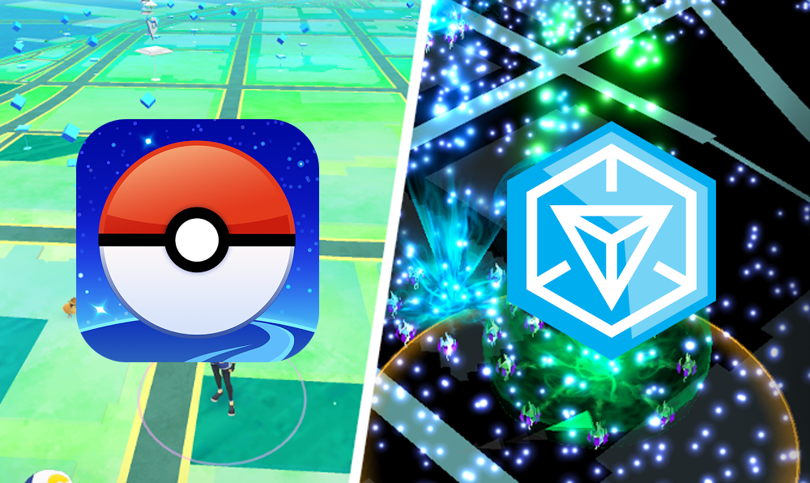
Source | Destination | Result
Cork City | Fota | No problem
Cork City | Dublin | 30 minute suspend
Cork City | London | 2 hour suspend
Cork City | Miami | Ban
Cork City | Miami (set bot to idle for half hour) | No problem
Notes:
So I initially tried Necrobot, it seemed powerful but I got banned twice around level 20. So I was thinking how do I get around this. Then I realised Pokemon Go was built on Ingress, so I pulled down an open source Ingress Bot, spent a while coding and gave it a trial. The results are as follows.
Seems the further away you are, you need to give it a small bit on time between location pings. The grater the teleport, the greater the punishment. Each trial was with a different account. 2 hours was sufficient for a teleport across the Atlantic anyways. The bots got 2 bots to level 32 and stopped and they were going at about 4-7km per hour, taking breaks, with a 3 hour rest period at night. Got by the ban stick!

Slide 11
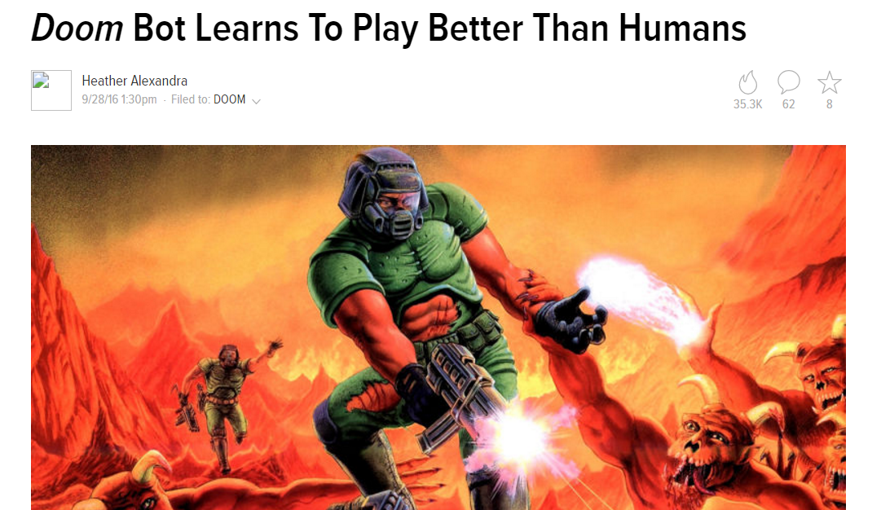
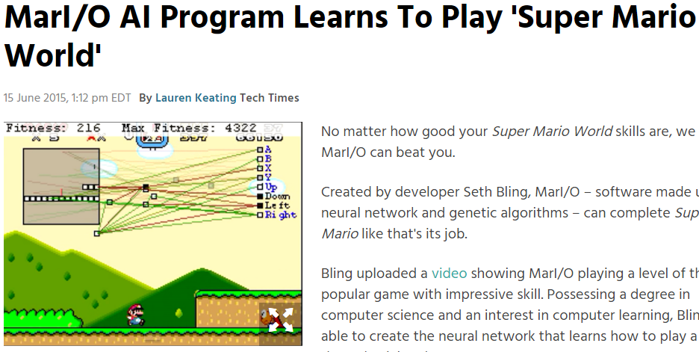
Notes:
Ok so if bots tend to do the same thing and act the same way, sure over time you would get better at detecting them? Well not true! Bots themselves are actually getting smarter too it seems. I know Doom and Mario are rather simple games in comparison to modern ones, but what the bots are being used for primarily is repeteitive simple time consuming tasks that players don’t do or don’t want to do. A bot can learn this routine and learn how to make it seem human. Detection will get hard!

Slide 12
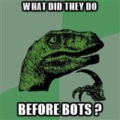
Notes:
So as you can see, a good bot can do all your work for you! So what did they do before bots?

Slide 13
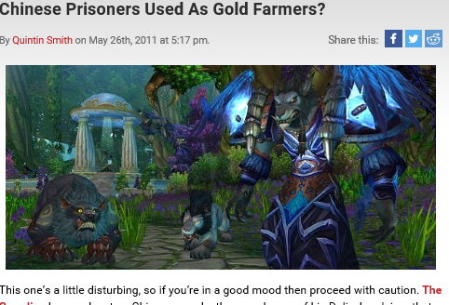
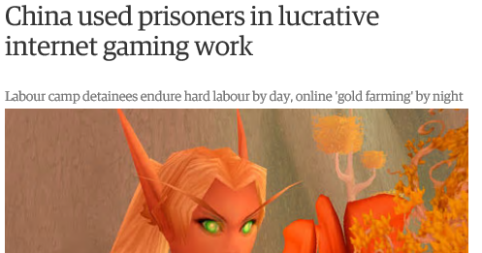
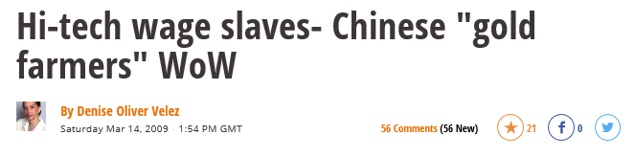

"If I couldn't complete my work quota, they would punish me physically. They would make me stand with my hands raised in the air and after I returned to my dormitory they would beat me with plastic pipes. We kept playing until we could barely see things,"
Notes:
Hire a chinese man! Whether buying gold they grind or renting their services to level on your behalf.
Now there was a bit of a dark side to all this gold farming, especially in the past. Prisoners in China would be forced to play the game and achieve daily gold quotas, if they did not get the quotas they were beaten. In 2009 China passed laws to try hinder the amount of this that goes on but seemingly it still goes on. I will go into this a bit more later on anyways.
The first time I encountered a Chinese power leveller was actually when a friend of mine hired a guy to spend 2 weeks levelling his character for him. The Chinese guy doing the levelling was surprisingly chatty actually.

Slide 14
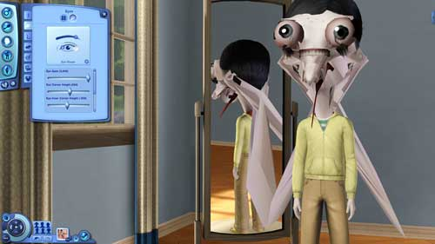
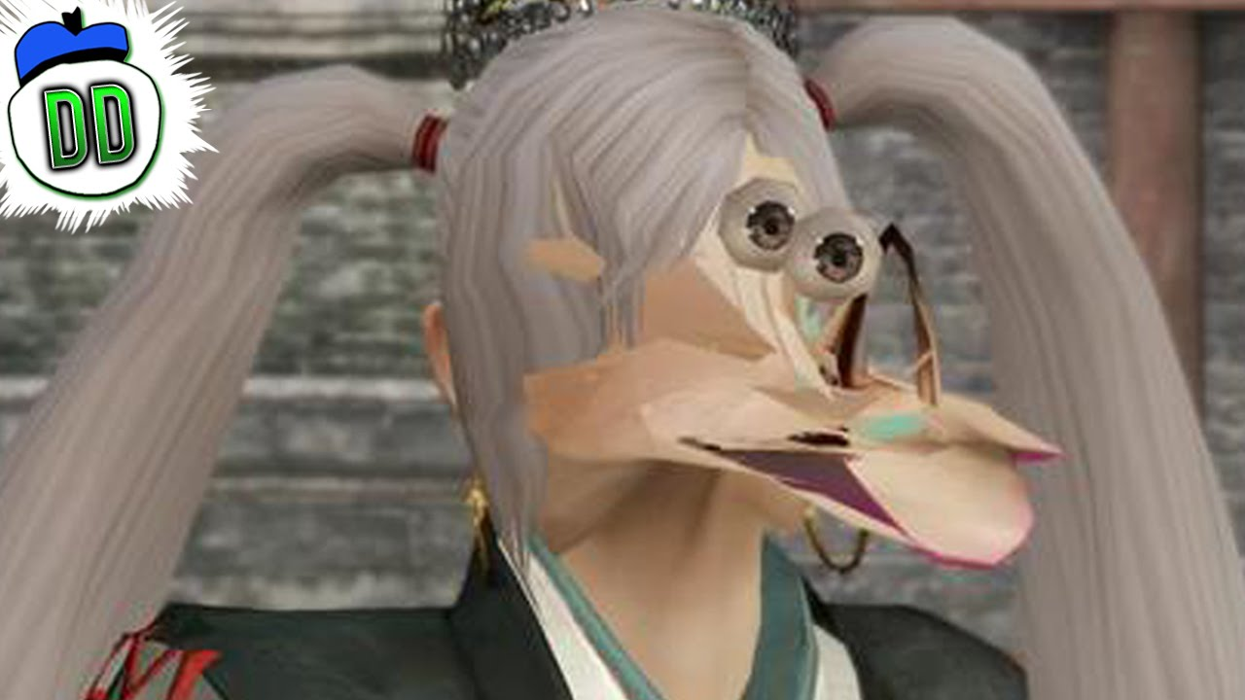
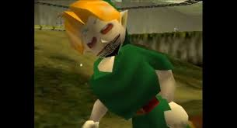

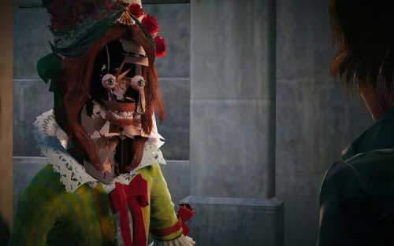
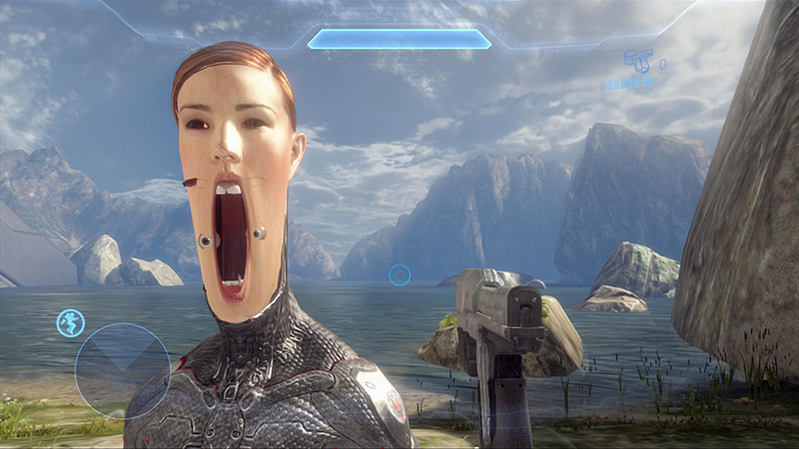
Glitches
Notes:
So now we have botting covered, time for glitches! Now you can often have graphical glitches which can be hilarious or creepy. Here are just a few. Personal favourite is stretchy neck marine in call of duty.
So aside from graphical, what are other glitches like and how do they affect the games?

Slide 15
Game | Action | Result
The Witcher 3 | Spam click without ever opening a specific chest | Infinite XP
Dragon Age Inquisition | Buy and sell back scrolls without closing the dialog box. | Infinite everything
World of Warcraft | Log out in Lions Pride Inn | Instantly gain max rested XP.
Mass Affect Andromeda | Sell minerals at full price to merchant with discount active. Buy back item at discounted price. | Infinite Cash
Notes:
Well here are a few examples.

Slide 16
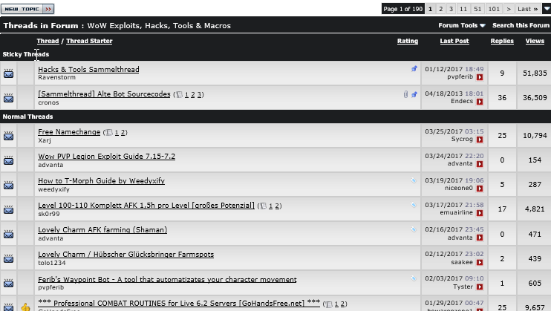
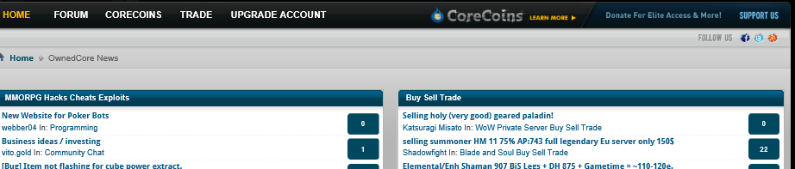
Notes:
There are sites that are full of lists of exploits for mmos and local games, so as issues come up people frequently post the exploits for other users to see/use. Gold farmers would use these exploits for quick gold if they can and if it does not get them caught. The issue is with public ones, then company knows the exist and they can then watch for people who abuse them.

Slide 17
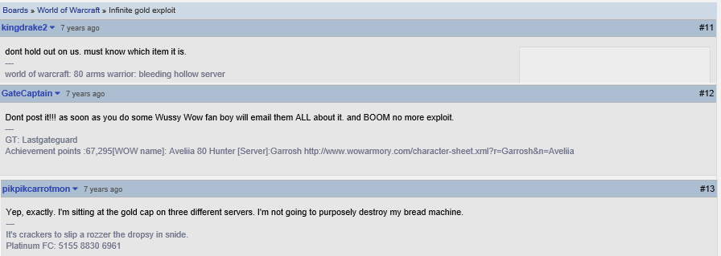
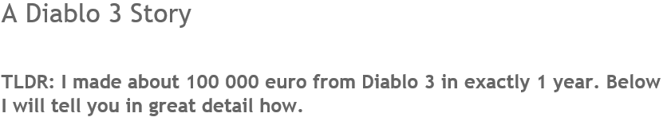
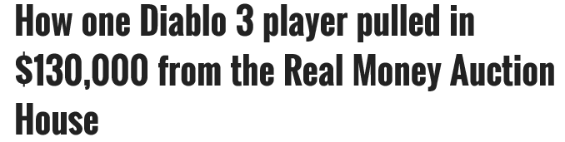
Notes:
What happens when people find bugs but don’t share them? Well pretty much what this conversation states.
When farmers find these exploits they keep them quiet or in a small circle, they also try not to draw too much attention to themselves with it.
Now you may think, ok so what if they have unlimited resources in an online game? It is only a digital currency, so what?
Well lets take the Diablo 3 real money auction house for example. You had an auction house you could spend in game currency to buy items bit you had another where you could sell items for actual money. There were players who were making 6 figures but bot based accounts were making more, significantly more. By using gold farming exploits they could gather the currency quick, then by monitoring the auction house prices they knew the good bargains so they quickly bought them and put them for sale on the real money auction house.

Slide 18
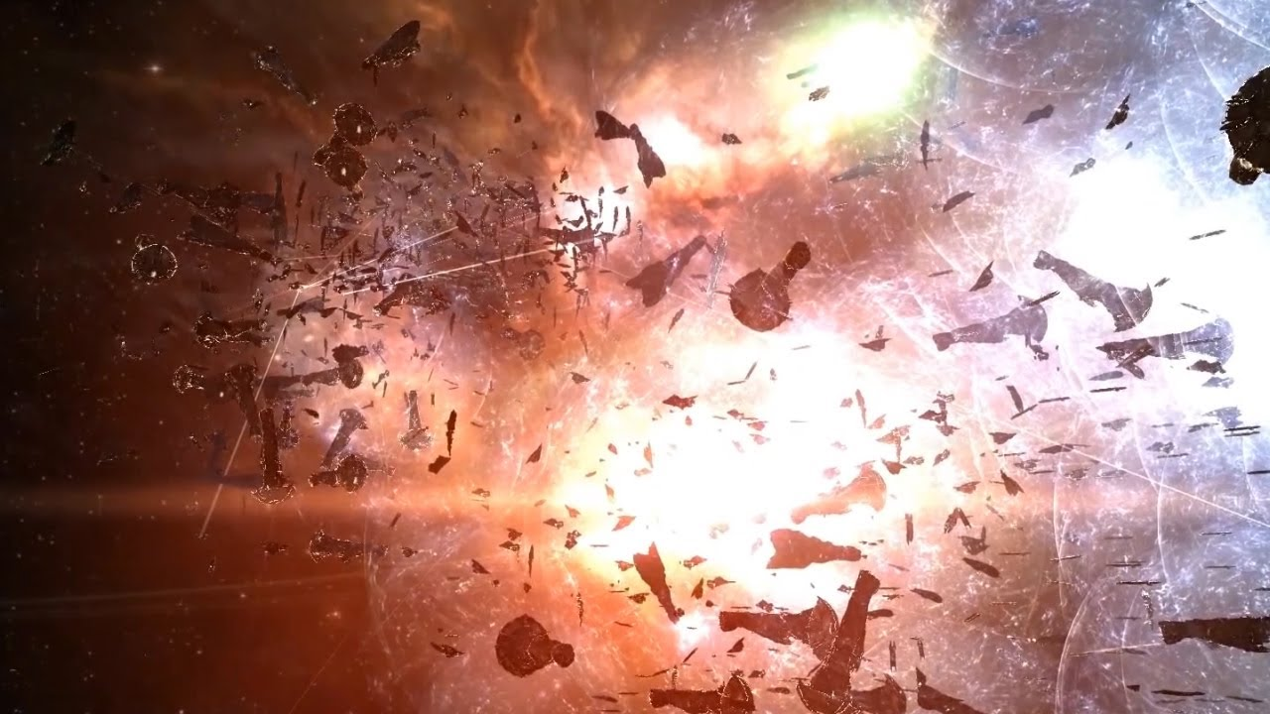
Game Economies
Bloodpath of B-R5RB, Halloween War.
Over €300k for this engagement
Over €1.1 million in the actual war.
Notes:
Well time to talk about game economies and I will start with Eve Online. I am personally not an Eve player so feel free to correct me at the end or add more details.
So this is the Battle of B-R5RB, this single fight cost over 300k worth of asset damage and this was a single incident in what was known as the Halloween War. Which went on for a few months, involving tens of thousands of players and cost over 1.1 million dollars worth of in game asset damage.
The in-game cost of the losses totalled over 11 trillion InterStellar Kredit
This theoretical value is derived from PLEX, an item purchasable with real currency that can be redeemed either for subscription time or traded for in-game currency.
Massive changes incoming in EVE around this. 1 Plex = $20, soon to be 500 Plex = $20
Imagine what would happen if someone had unlimited ISK? They could sell this on to sites that sell ISK, make a nice real world profit and then the site make profit when it sells it. This significant increase in currency available on the server would then affect the value of the currency. The makers of Eve online have actual economists on there staff to monitor the economy for things out of the ordinary like this.
An interest thing happened during and just after this battle too. While the battle was underway, one of the key resources needed for building ships was being bought up by what was later to be revealed as bot accounts, it was then being put back up for sale at several times the purchase price. After the battle, when the players were trying to recover the bot accounts made a fortune. So auction house style botting where they monitor sales prices and watch for events that could affect the price is another type of bot – World of Warcraft even has mods to help you do this on your own!

Slide 19
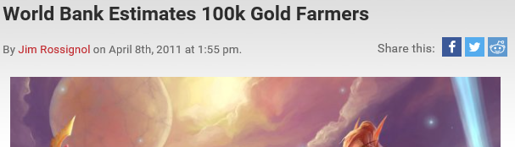
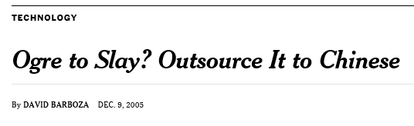
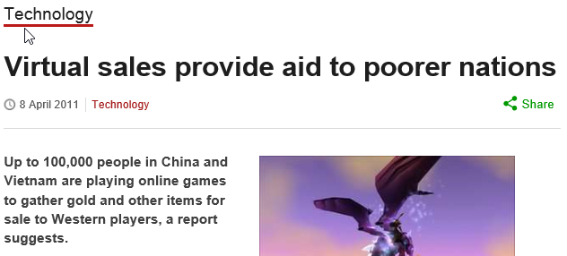
Employed over 100,000
Third Party Games Service valued over $3 billion
50% bots
30% players
20% hacks
Notes:
So remember I mentioned gold farmers earlier? Well here are some figures on them!
KNOWLEDGE MAP OF THE VIRTUAL ECONOMY
In 2011 there was over 100k of them world wide. Spending 12 hours a day, 7 days a week playing these games collecting the in game currency, selling it onto online sites who then sell it to the customers. The online seller makes the largest amount of the profit with only a small amount going to the actual farmer.
A good farmer can make anything from $75-$250 a month doing this 84+ hour a week job.
In more recent reports they have suggested this number is as high as 250,000 spread across a much larger amount of games. Games like World of Warcraft have significantly less than they used to. Why you may ask?

Slide 20
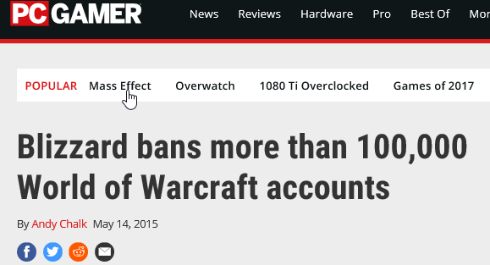
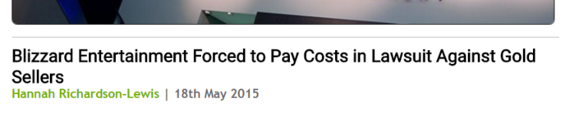

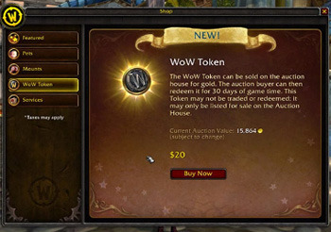
Notes:
Well Blizzard is getting better at detecting bots, gold farming and a lot of the older exploits that were being abused are fixed. Plus grinding for gold is a lot quicker than it used to be.
Blizzard have also been taking legal proceedings against many of the bot makers and gold farmers, how goes it? Well it varies.
The addition of things like The WoW token also provide people with the ability to legally get their own WoW gold in game.

Slide 21
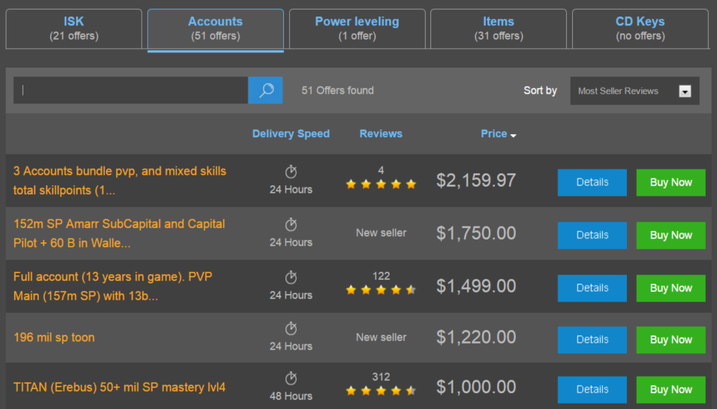
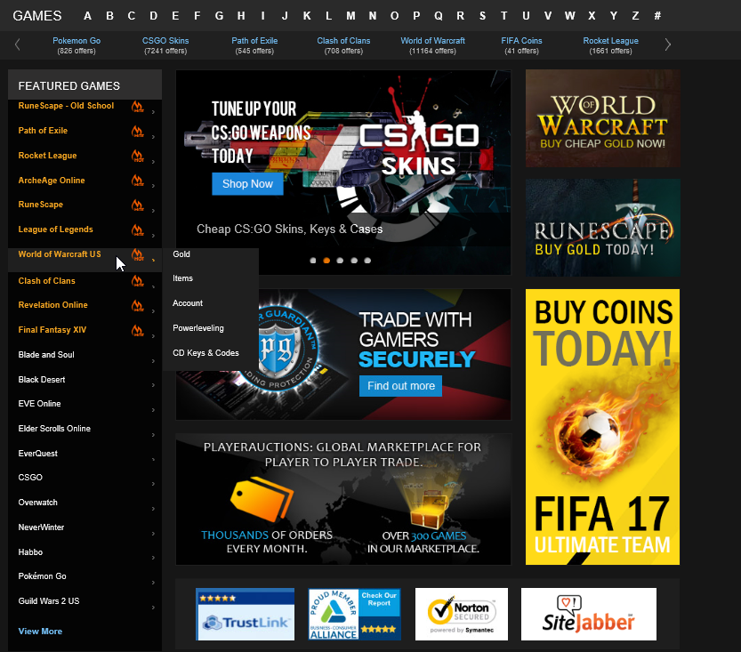
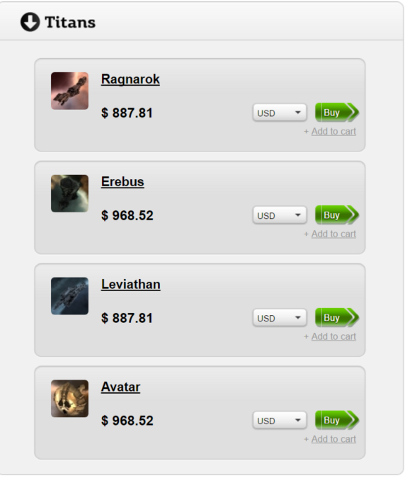
Market
Notes:
Ok so aside from gold, what else can the market offer me and do companies provide alternative to try combat this?
Gold: They can sell gold to their users or a means of obtaining it.
Power levelling: They offer level boosts.
Items: Only a few let you buy the item you want. This is still something sites can sell.
Accounts: People/farmers actually sell accounts they have levelled and invested time into getting to a certain quality level. People then buy the account. Companies don’t offer this generally and it is highly opposed. First time I seen this was with Shizar, a Troll Shaman in our WoW guild. Sold his account for 1,500 dollars.
Ok so aside from all this, is there any other things that can be arranged on these markets aside from these services or any stories to share?

Slide 22
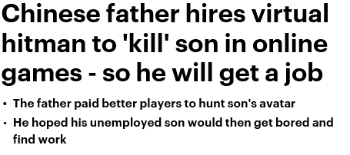
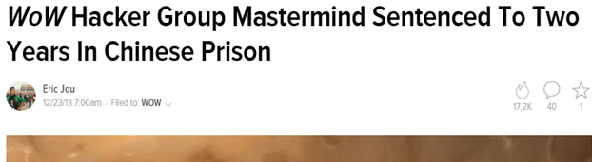
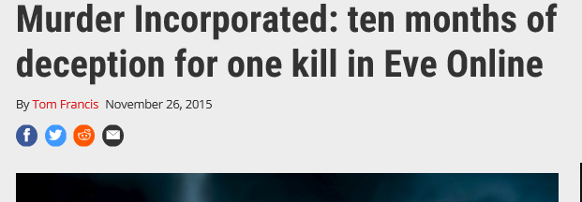
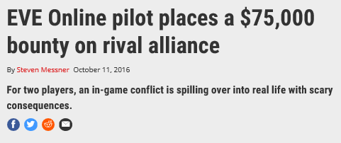
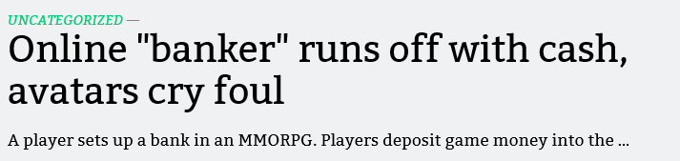
Notes:
Well here are just a few ..
- Chinese father hires virtual hitmen to keep killing his son.
- WoW hacker group who would hack upon request and hack lots of random accounts. Many other groups active.
- Heist
$16,500 worth of stuff destroyed and thousands more stolen.
Paid $500 for hit
Keyword Nicole
The only thing they wanted was her body?
-----------------------------
- Paypal bounty splitting 75,000 among all the players who participate in the fight if it is successful.
-----------------------------
- Eve online scam $170,000 in real money. Entirely legal, until they try to convert the digital currency into real money. Then it is illegal.
So yeah, that is pretty much it. Hopefully I have given you a better idea of game economies, the issues with bots, glitches and the black markets and what not.

Slide 23
